Slide 1

Phishing Awareness – Recognizing and Avoiding Cyber Threats

Slide 2
Introduction
Phishing is a type of cyber attack.
Involves tricking individuals into revealing sensitive information.
Importance of Phishing Awareness.

Slide 3
Types of Phishing Attacks
Social Engineering
Email Phishing
Manipulating individuals to divulge confidential information
Deceptive emails to extract information
Examples: Impersonation, emotional manipulation.
Examples: Fake security alerts, account verification requests.
Website Phishing
Fraudulent websites imitating legitimate ones.
Examples: Fake login pages, malicious websites.

Slide 4
Common Characteristics of Phishing Attempts
Urgency: Creating a sense of immediate action.
Unexpected Emails: Receiving unsolicited emails.
Suspicious Links: Hover over links to preview URLs
Requests for Personal Information: Be cautious.

Slide 5
Recognizing Phishing Emails
Check the Sender's Email Address.
Verify Email Content.
Look for Spelling and Grammar Mistakes.
Hover Over Links to Preview URLs.

Slide 6
Recognizing Phishing Websites
Check the URL.
Verify Website Legitimacy.
Look for HTTPS.
Be Cautious with Pop-Up Forms.

Slide 7
Social Engineering Tactics
Impersonation Techniques.
Exploiting Human Emotions.
Awareness of Social Media Manipulation.
Manipulation of Trust.

Slide 8
Protecting Personal Information
Never Share Passwords via Email.
Use Two-Factor Authentication.
Verify Requests for Sensitive Information.
Be Cautious with Personal Information Sharing.

Slide 9
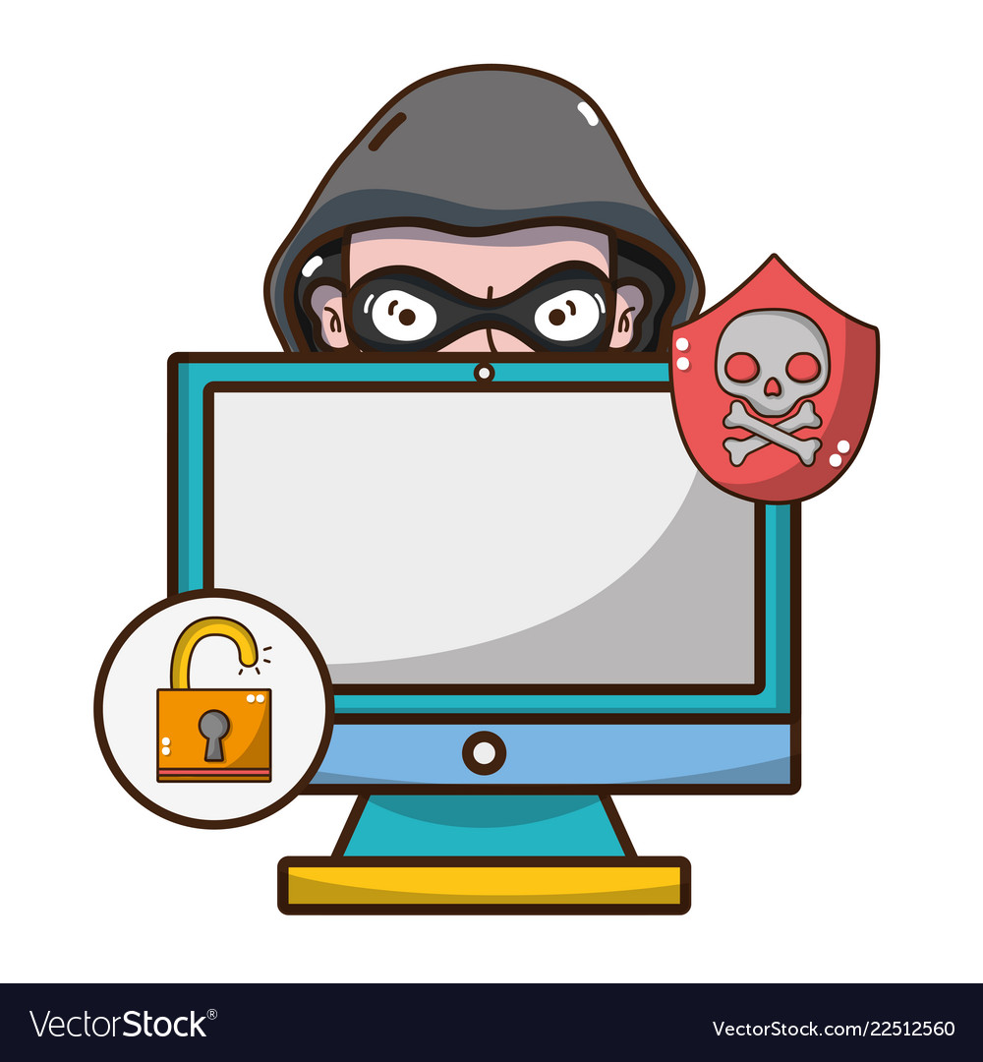
Best Practices for Avoiding Phishing
1
Keep Software Updated and Use Security Software.
2
Educate and Train Employees.
3
Regularly Backup Important Data.

Slide 10


Slide 11


